Slide 1
Distributed ML with Apache Spark
By @satwikkansal

Slide 2
About me
Former Software Developer @ Myntra
Co-founder @ Frobyt
Author of “What the f*ck Python”, “Hands on RL with Tensorflow”
GSoC ‘17 student, GCI ‘17 mentor, GSoC ‘18 mentor
Notes:
Knowledge for the session

Slide 3
Distributed Machine Learning with Apache Spark

Slide 4
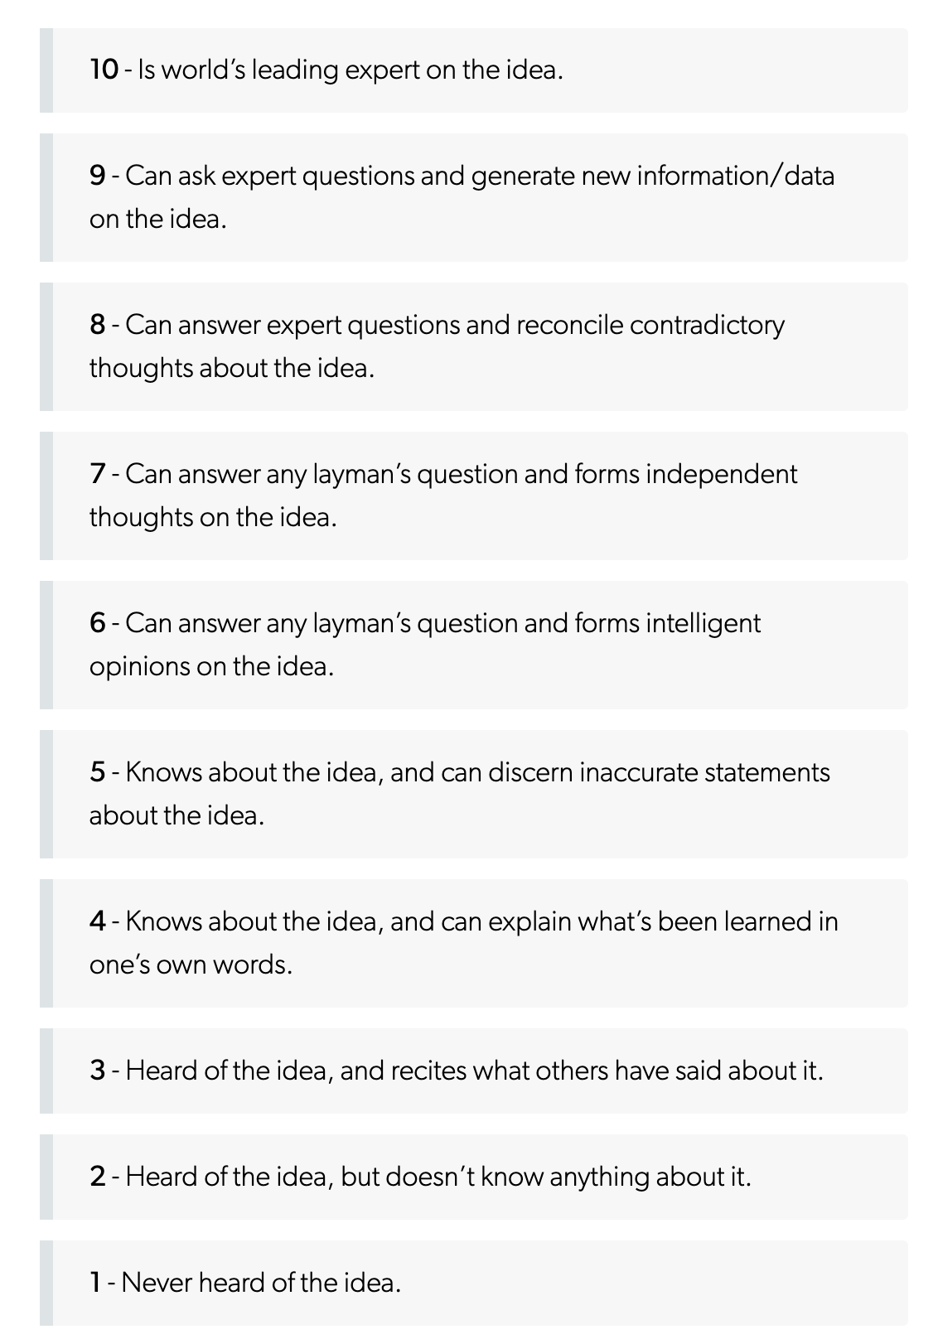
Goal of the session
Spark
Spark

Slide 5
What do we mean by Distributed mean here?

Slide 6
Distributed: Multiple devices a.k.a cluster of devices working in coordination to carry out a computation.
Notes:
Devices granularity: Cores, Machine, group of nodes.

Slide 7
ML: Learning from data and generating inferences. Supervised / Unsupervised.
Notes:
Q

Slide 8
Okay, but what is Apache Spark?

Slide 9
Spark: General-purpose cluster-computing framework for processing big data.
Notes:
Bottoms up

Slide 10
If I know numpy / tensorflow / pytorch already. Why use Spark for ML?
Notes:
Easy scaling out
H Tuning

Slide 11
Why use Spark for ML?
To process large volumes of data.
Parallelize parts of computation that are independent to each-other.
Scale-on-demand while keeping your old hardware still useful.
Notes:
Come to the third point later.

Slide 12
Different approaches to parallelism

Slide 13
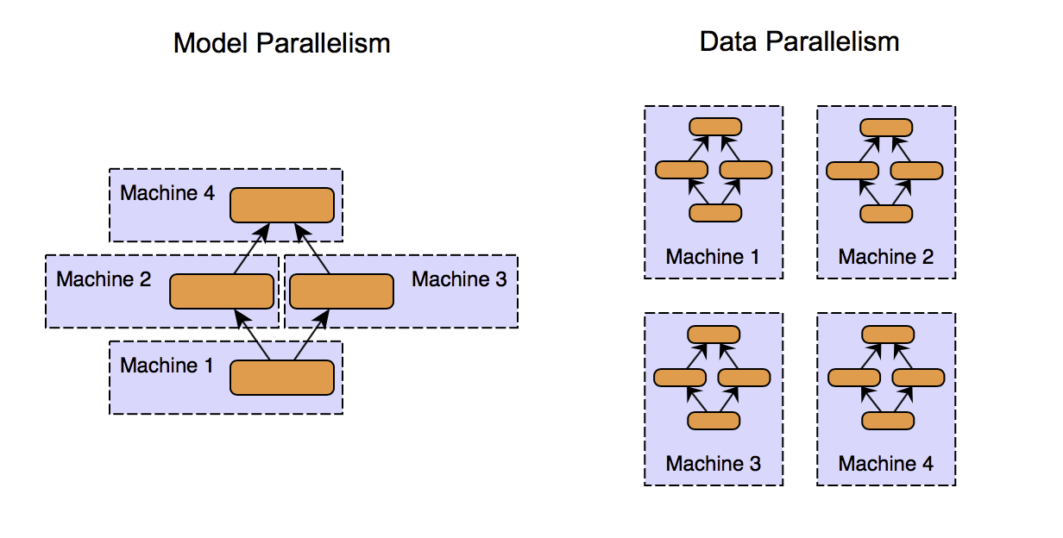
Notes:
One instance where you can see both the functional and data decomposition in action is the training of an ensemble learning model like Random forest, which is conceptually a collection of decision trees. Decomposing the model into individual decision trees is "functional decomposition," and then further training an individual tree parallelly is data parallelism. It is also an example of what we can call as an embarrassingly parallel task. Embarrassingly parallel tasks can be theoretically scaled infinitely by horizontally partitioning the data and adding more computing machines. A MapReduce based framework implicitly exploits data-parallelism by partitioning the data and assigning concurrent processing tasks to the cluster nodes that can run independently. The term "independently" is important here, because if there’s a dependency between the tasks, i.e., tasks need to wait for other tasks to finish, the efficiency gets reduced. An example of such a case can be found most similar documents from a corpus, where we will have to evaluate every pair of documents together at least once to compute the similarity.

Slide 14
Thinking in terms of “data-parallelism”

Slide 15
Map-Reduce paradigm

Slide 16
What is MapReduce programming paradigm
Programming model based on “split-apply-combine” strategy.
Map operation maps the data to zero or more key-value pairs.
Reduce function takes in those key-value groups and performs aggregation to get the result.
MapReduce execution framework takes care of handling the data, running the map and reduce operations in a highly optimized and parallelized manner on the cluster, resulting in a scalable solution.
Notes:
Programmer: 2 major operations complemented by framework that takes care of everything else.

Slide 17

Map-Reduce Example
4o random cards from a deck of cards
Objective: Compute sum of numeric cards for each suite.
How would,
A single person do it?
A group of 4 people do it?

Slide 18

Single-person style (4o cards)

Slide 19

4 people style (Split into 10 cards each)

Slide 20
Apply the same process (Map)
Person A (10 cards)
Person B (10 cards)
Spades | 7
Diamonds | 5
Clubs | 8
Hearts | 10
Spades | 11
Diamonds | 3
Clubs | 4
Hearts | 9
Person C (10 cards)
Person D (10 cards)
Spades | 5
Diamonds | 15
Clubs | 6
Hearts | 4
Spades | 2
Diamonds | 8
Clubs | 6
Hearts | 12
Notes:
Spades
7
Diamonds
5
Clubs
8
Hearts
10

Slide 21
Sort and shuffle the results
Person A (All spades)
Spades (A) | 7
Spades (B) | 11
Spades (C) | 5
Spades (D) | 2
...
Person B (All diamonds)
...
...
Person C (All clubs)
...
...
Person D (All Hearts)
...
Notes:
Spades
7
Diamonds
5
Clubs
8
Hearts
10

Slide 22
Combine (Reduce)
Person A: Sum of spades is 25
Person B: Sum of diamonds is 34
Person C: Sum of clubs is 24
Person D: Sum of hearts is 35
Notes:
Spades
7
Diamonds
5
Clubs
8
Hearts
10

Slide 23
A MapReduce framework implicitly exploits data-parallelism by partitioning the data and assigning concurrent processing tasks to the cluster nodes that can run independently.
The term "independently" is important here, because if there’s a dependency between the tasks, i.e., tasks need to wait for other tasks to finish, the efficiency gets reduced.
Notes:
No “getting carried away” zone.

Slide 24
Note: Spark is more than just Map-Reduce.

Slide 25
For History Fanatics

Slide 26
How Spark came into picture?
Google pioneered MapReduce for running queries on its massive datasets of web pages.
Apache Hadoop is currently the most popular MapReduce framework, which was started as an open source project to implement the ideas discussed in the MapReduce paper published by Google.
MapReduce kind of proved that cluster of machines working together is both faster and cheaper than a single really powerful machine.
As time passed, multiple limitations of in Hadoop became apparent, and efforts were made to get around those limitations. The Spark project was launched as one such effort and is maintained by Apache.
Notes:
Google -> Hadoop -> Others

Slide 27
Spark performs better (than Hadoop) for iterative tasks where data can easily fit into the memory; that’s why it’s a good choice for performing machine learning.

Slide 28
Spark Architecture
Notes:
History done, high level spark introduction.

Slide 29
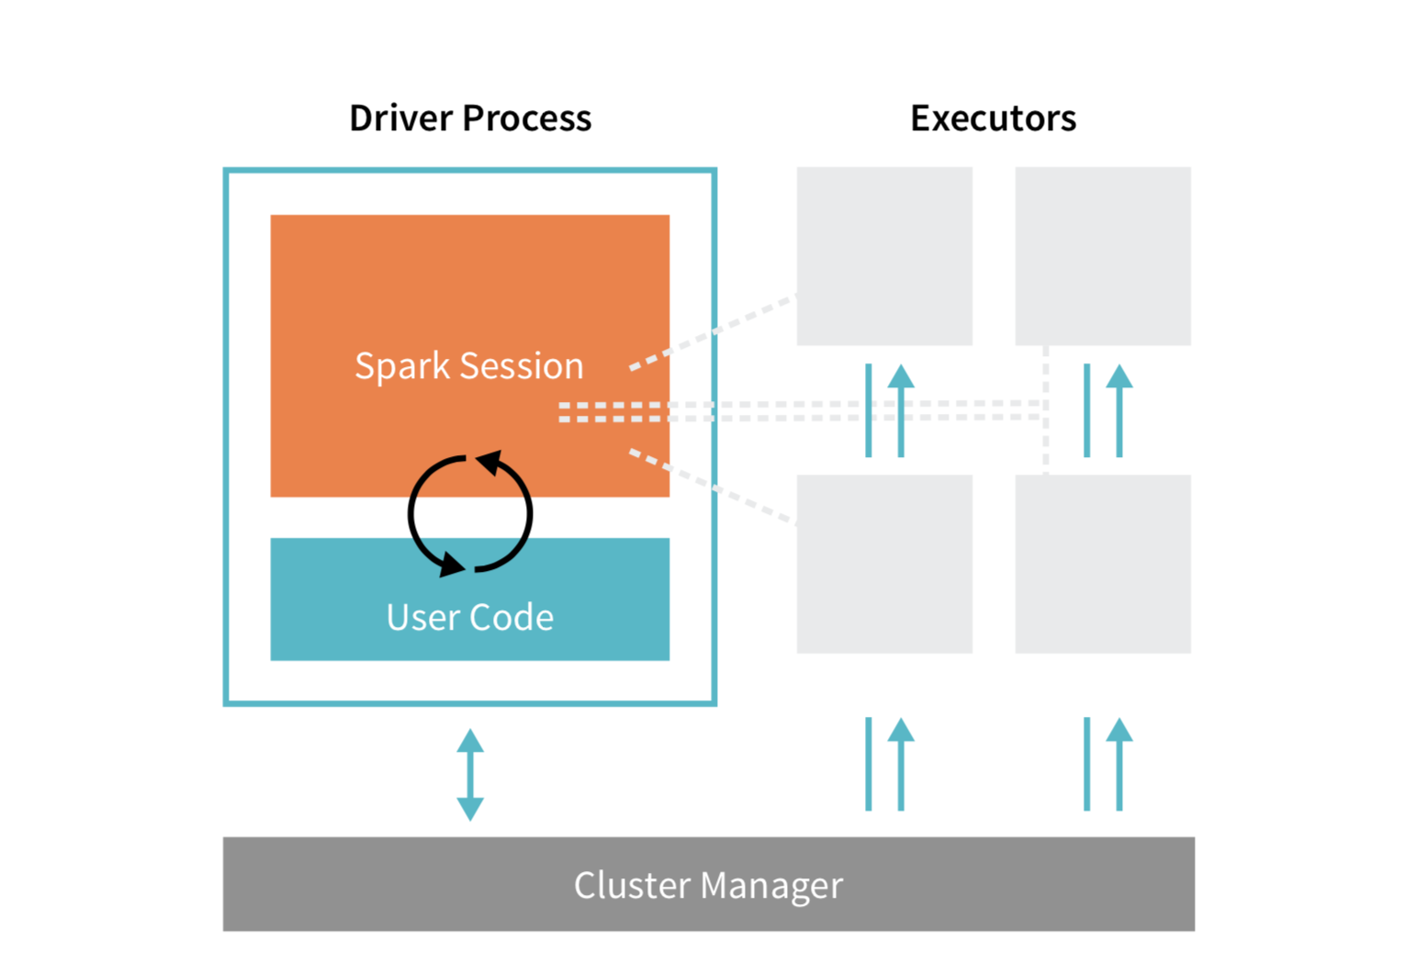
Notes:
Master slave via cluster manager. Workers. SparkContext.

Slide 30
The Driver process
Spark has a master-slave (driver-worker) architecture. The driver is the central-coordinator.
It connects to the Cluster manager for managing worker nodes in which executors run. Driver and each of the executors run in their Java processes.

Slide 31
Local and distributed modes

Slide 32
Spark local
Local mode is suitable for testing and prototyping.
Spark local is a multi-threaded non-distributed runtime environment.
The degree of parallelism is determined by the number of threads specified at the time of instantiating the Spark Application.
Doesn’t require a cluster manager.
The drivers and the executors are spawned inside the same JVM in Spark local.

Slide 33
Cluster manager
The distributed mode, on the other hand, requires a cluster manager
A cluster manager is responsible for spawning executor processes on the workers.
The workers communicate the resource availability (CPU and memory) to the cluster manager, and the cluster manager conveys this information to the driver whenever requested.
Spark has a built-in cluster manager called Spark Standalone, and we can also plug other cluster managers like Hadoop YARN and Apache Mesos.

Slide 34
Layers of abstraction of Spark APIs

Slide 35
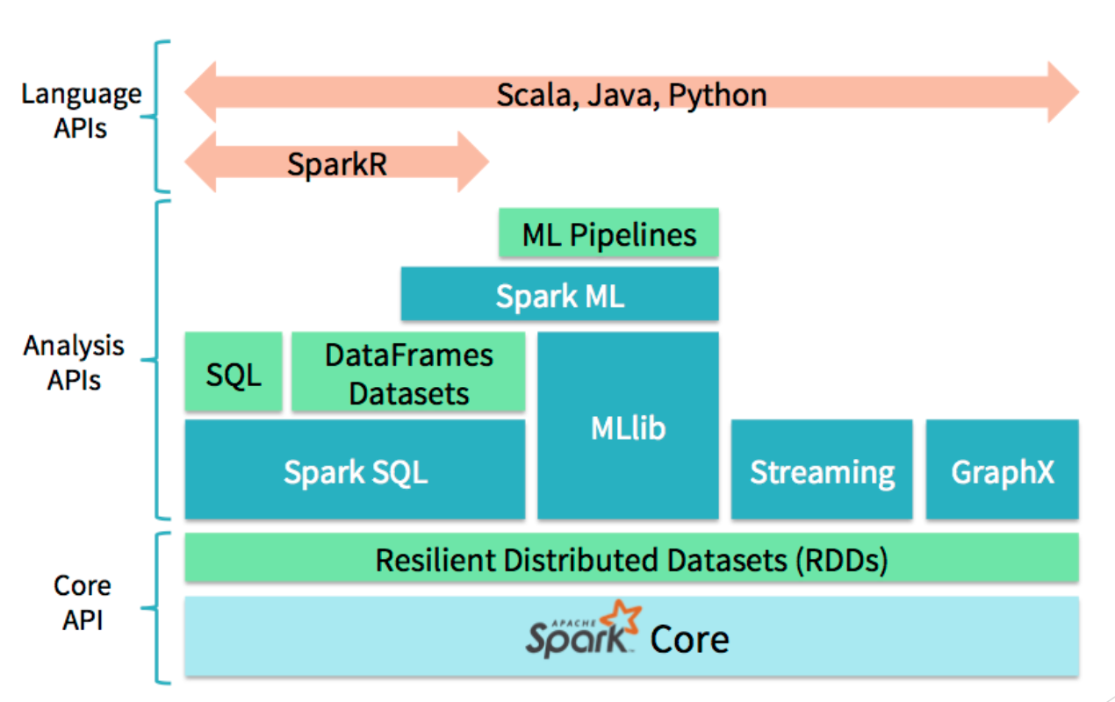
Notes:
No getting carried away zone.
Core is structure.

Slide 36
Hello PySpark! (PySpark hello world)

Slide 37
The cliched word count example.

Slide 38
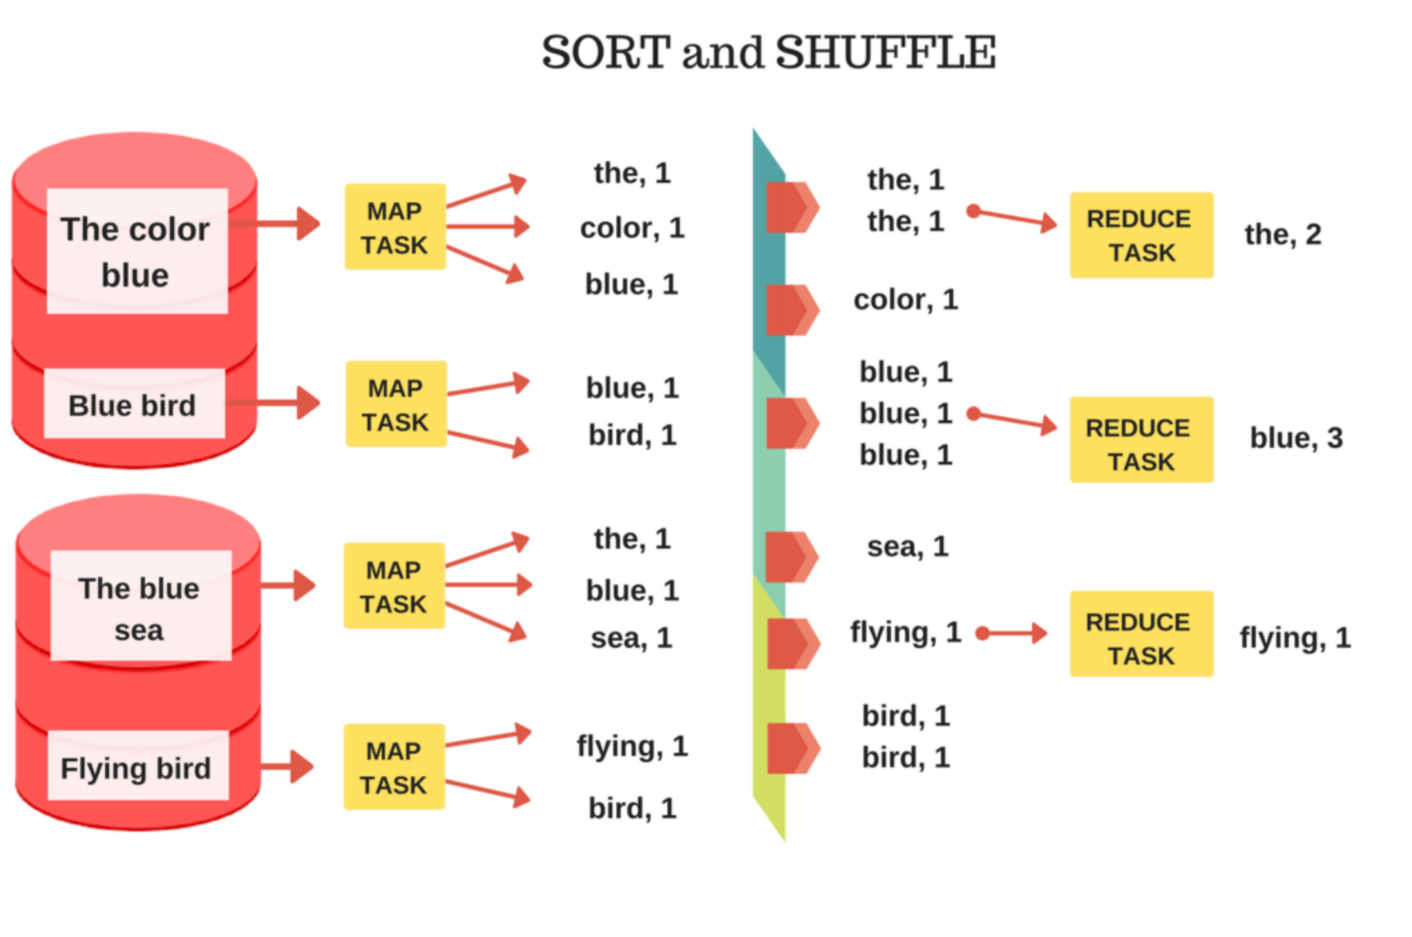
Notes:
Multiple records, multiple places. Read is abstracted. Move to the code next.

Slide 39
Some important PySpark constructs
Notes:
Building vocab.

Slide 40
RDDs

Slide 41
Resilient Distributed Databases
Partitioned: An RDD is divided into multiple partitions. Different executors can concurrently perform computations on different partitions of RDD.
Distributed: An RDD resides on multiple nodes across the cluster. A node need not have all the partitions of RDD.
Resilient: If one of the nodes containing the partitions fails, Spark has mechanisms to recover the lost data.
Immutable: An RDD is a read-only object and cannot be modified. Transformation operation on RDDs generates a newer RDD.

Slide 42
Operations in Spark
Transformations and Actions

Slide 43
Transformation operations in PySpark
A transformation operation returns a new RDD.
Some commonly used transform operations in PySpark are:
map, flatMap, mapValues
filter
distinct
union, intersection, subtract, cartesian
reduce, reduceByKey

Slide 44
Actions in PySpark
An action returns a non-RDD object.
Some commonly used actions in PySpark are:
collect
count, countByValue
take, takeOrdered
top

Slide 45
Execution in Spark

Slide 46
Execution plans
Spark records the sequence of operations applied to RDD in the form of Direct Acyclic Graph (called RDD lineage).
Two important components of SparkContext are the "DAGScheduler" and "TaskScheduler".
The DAGScheduler transforms the logical execution plan (RDD lineage) to physical execution plan (TaskSets), one that's actually executed on workers.
TaskScheduler is responsible for distributing these tasks to the executors through cluster manager.
Notes:
Failure case of Lineage.

Slide 47
Jobs, stages and tasks
A Job in spark is the logical unit of execution, which is submitted to the DAGScheduler to compute the result of an action.
A Stage is a physical unit of execution, it is a step in the physical execution plan. A stage consists of a set of parallel tasks (for different RDD partitions and executors).
The Tasks are the smallest physical units of execution responsible for performing computation on a single partition of RDD.
Notes:
Other set of critical vocabulary.

Slide 48
Lazy execution
The transformation operations are executed lazily in Spark, i.e., the job is not submitted to the DAGScheduler for generating theTaskSets until an action is encountered in the RDD lineage.
Lazy execution is the reason why printing the RDD in our example above just prints the object information and not the data (somewhat similar to generators in python). When the collect action is invoked, the operations are executed, and we get our data.

Slide 49
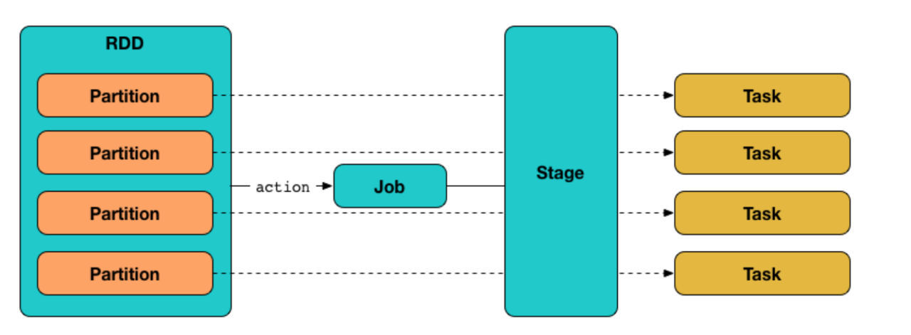

Slide 50
Narrow and wide transformations.
Narrow transformations are the result of operations like map and filter which depend on data from a single partition only.
An output RDD for these operations has partitions with records that originate from a single partition in the parent RDD.
Wide transformations are the result of operations like reduceByKey. The data required to compute the records in a single partition may reside in many partitions of the parent RDD.
All of the tuples with the same key must end up in the same partition, and are processed by the same task.
To satisfy these operations, Spark must execute RDD shuffle, which transfers data across cluster and results in a new stage with a new set of partitions.
Notes:
VISUAL FIRST.
Wide dependency: Person A waiting for other people to report numeric sum of Spades by other 3 persons.
Moving data around is expensive!!

Slide 51
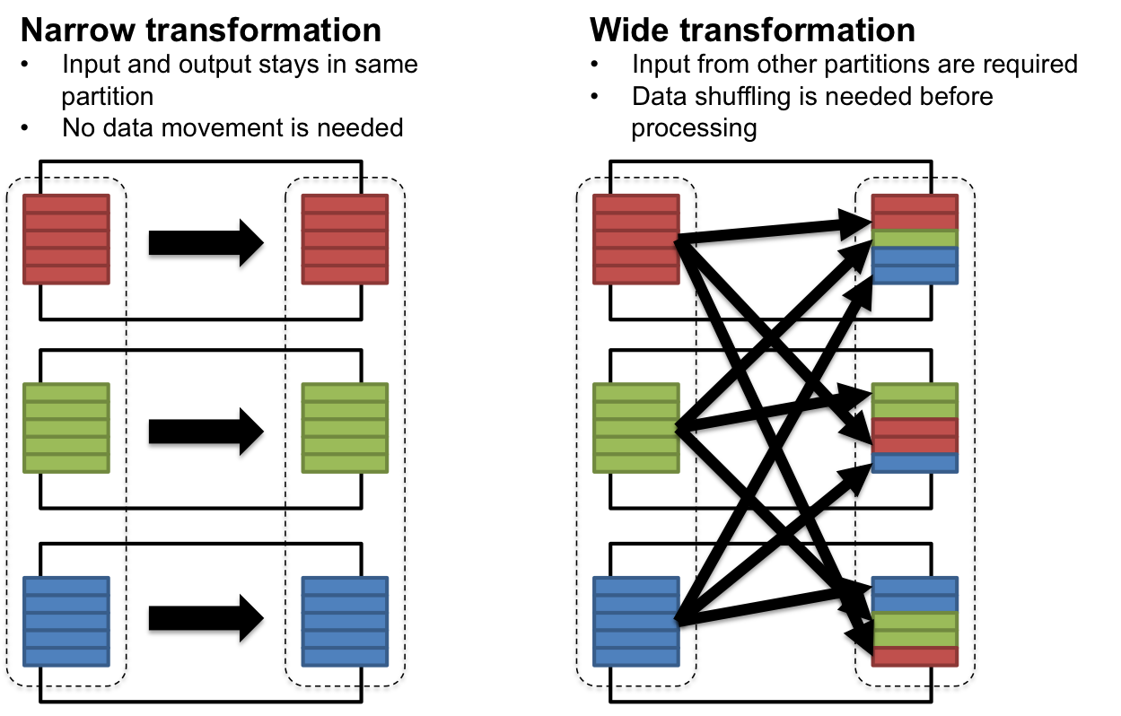

Slide 52
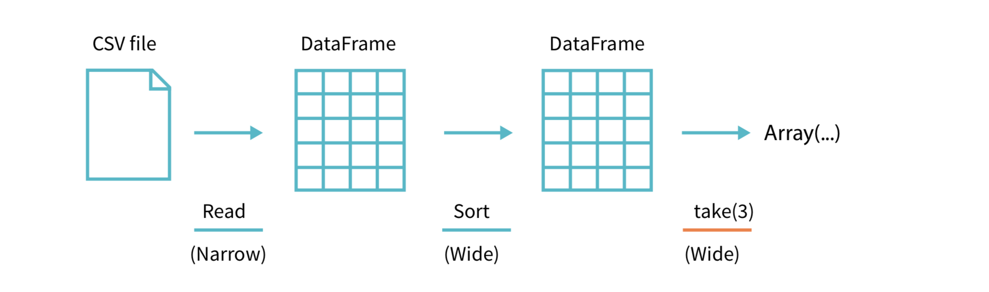
Narrow and wide transformations.

Slide 53
Putting everything together into perspective...

Slide 54
Visualizing things with Spark dashboard

Slide 55
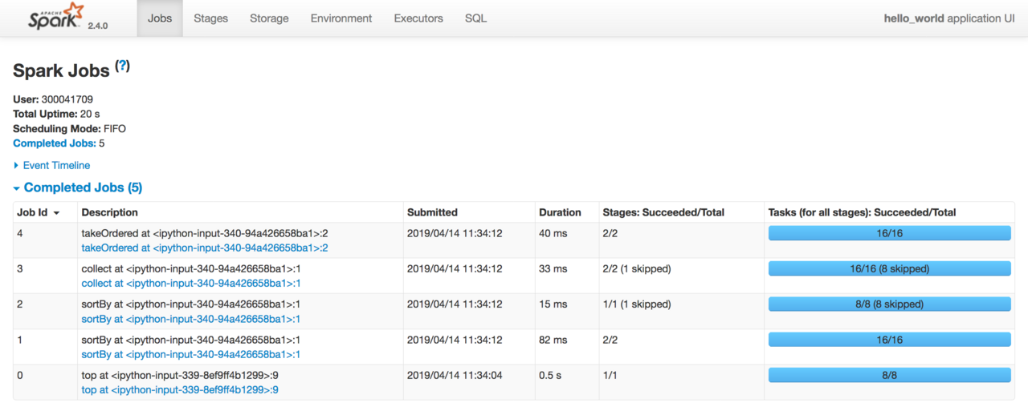

Slide 56
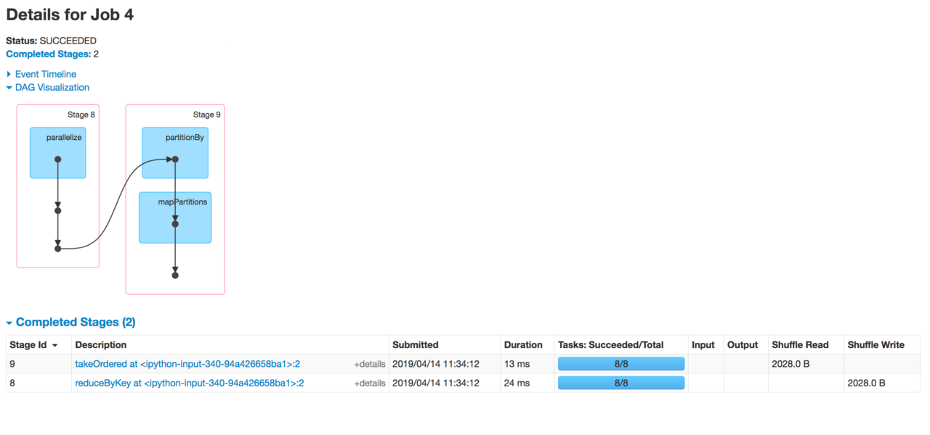

Slide 57
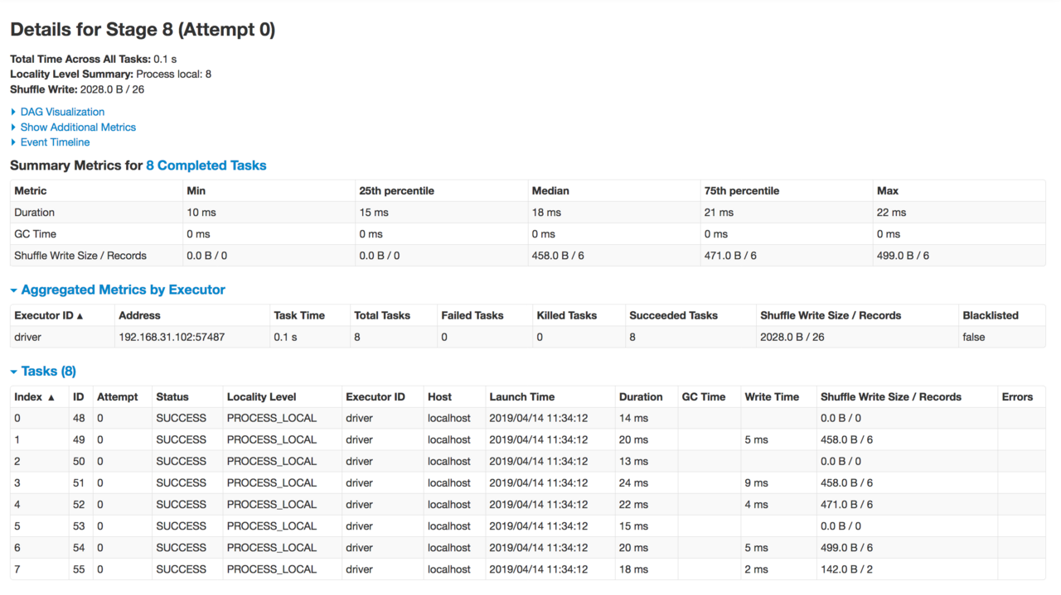

Slide 58
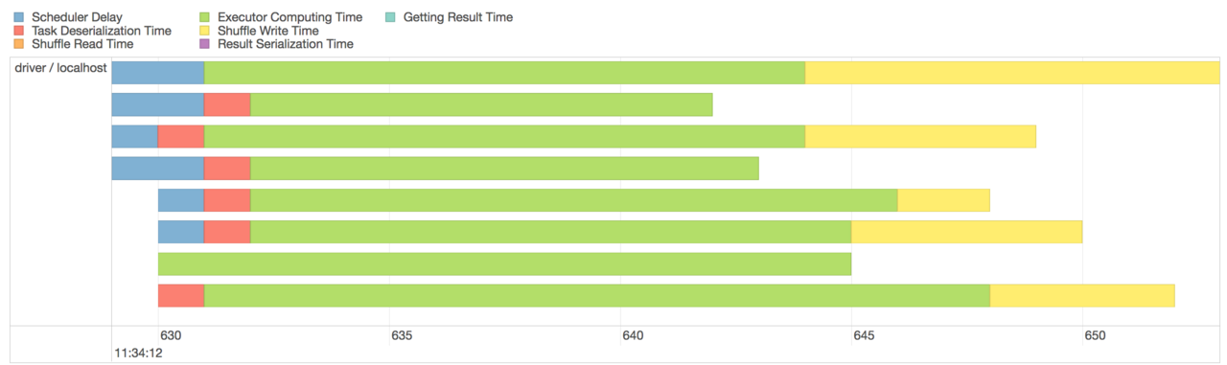

Slide 59
Let’s implement linear regression in PySpark

Slide 60
Typical ML process
Gathering and collecting relevant data
Data cleaning, and inspection (EDA)
Optional data processing and train-test split
Train test split and generating some candidate models.
Evaluating and comparing models
Using the model to make predictions, recommendations, detect anomalies or solve more general business challenges.

Slide 61
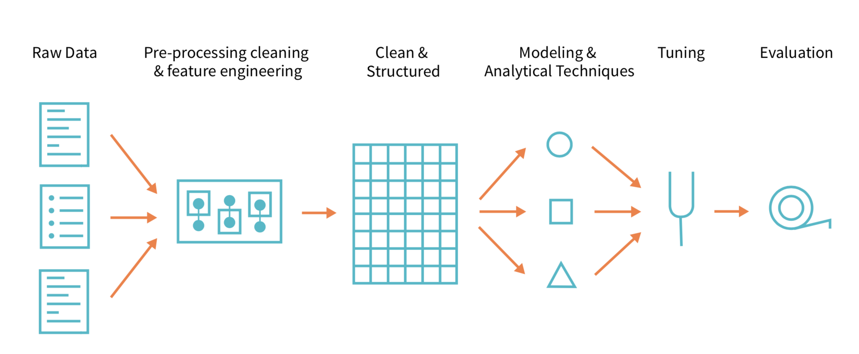

Slide 62
Spark in production: Beyond local environment and linear regression
Notes:
Things to do usually at production level.

Slide 63
Use Structured APIs (Dataframes and Datasets)

Slide 64
SparkML and MLlib

Slide 65
SparkML and MLlib
Both packages leverage different core data structures.
SparkML maintains an interface for use with Spark DataFrames.
SparkML also maintains a high level interface for building machine learning pipelines that help standardize the way in which you perform the above steps.
MLlib maintains interfaces for Spark’s Low-Level, RDD APIs. o use its features, we've to work with data models like Vector, LabeledPoint, and Matrix.
MLlib has now been pushed to maintenance mode.

Slide 66
High level SparkML concepts
Transformers: Pre-processing the raw data and feature generation (manipulate columns)
Estimators: Models that we’ll be training to make predictions
Evaluators: Mechanisms to evaluate estimators based on some criteria.
Stage: Single pass of data through transformers / estimators / evaluators.
Pipeline: Sequential specification of stages, similar to scikit-learn’s pipeline concept.

Slide 67
Some nice-to-know things
For most algorithms,
The training data has a single feature column called “features”, and label column called “label”.
Accepted data-structure for features is “Vector of Doubles” (could be sparse or dense).
You can use R-formula for specifying transformations declaratively.
Fitting an ML model (calling fit method) is always eagerly performed.
To make predictions, we call the transform method on the fitted model.

Slide 68
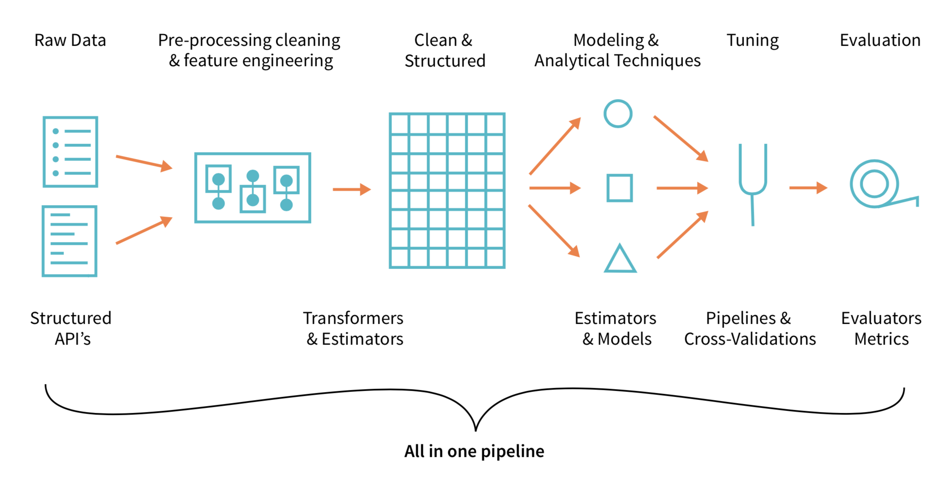

Slide 69
Structured streaming

Slide 70
Structured Streaming in Spark
High-level API for building continuous applications, Spark 2.x onwards
How it works?
You can load stream from “replayable sources” (Kafka, Kinesis, filestream, etc) into Datasets and Dataframes.
You can then describe the batch-job like query, and spark will take care of running them incrementally incrementally, ensuring “Consistency”, “Fault tolerance”, and “Order”.
The outputs of the query are “transactionally” written to sink (File sinks, in-memory sinks, databases)
Use cases: ETL pipelines, Online machine learning
Notes:
At any time, the output of a continuous application is equivalent to executing a batch job on a prefix of the data.

Slide 71
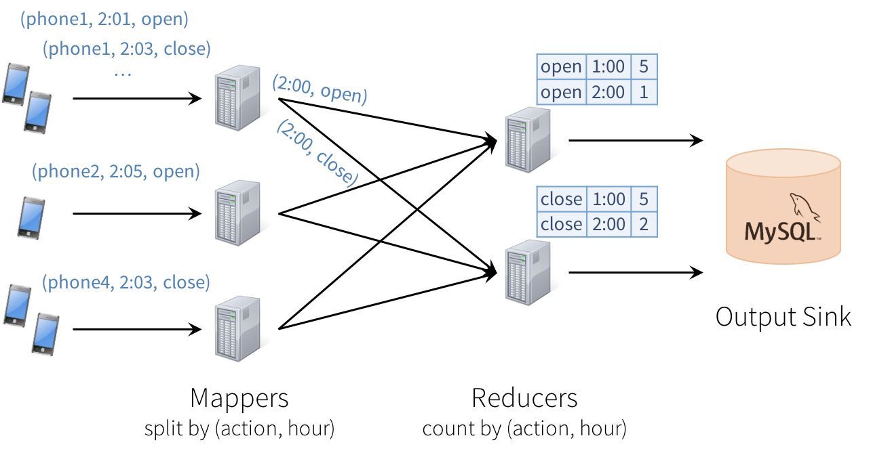
Notes:
Consistency: This distributed design can cause records to be processed in one part of the system before they’re processed in another, leading to nonsensical results. For example, suppose our app sends an “open” event when users open it, and a “close” event when closed. If the reducer node responsible for “open” is slower than the one for “close”, we might see a higher total count of “closes” than “opens” in MySQL, which would not make sense. The image above actually shows one such example.
Fault tolerance: What happens if one of the mappers or reducers fails? A reducer should not count an action in MySQL twice, but should somehow know how to request old data from the mappers when it comes up. Streaming engines go through a great deal of trouble to provide strong semantics here, at least within the engine. In many engines, however, keeping the result consistent in external storage is left to the user.
Out-of-order data: In the real world, data from different sources can come out of order: for example, a phone might upload its data hours late if it’s out of coverage. Just writing the reducer operators to assume data arrives in order of time fields will not work—they need to be prepared to receive out-of-order data, and to update the results in MySQL accordingly.

Slide 72
Setting up cluster

Slide 73
DIY
Procure multiple machines
Add master and slave DNS lookup entries in /etc/hosts file
Configure ssh to slaves on master node
Install java and Spark binary
Add master and slave node configurations (IPs, Java home, etc)
Start cluster from master
Use Spark Master UI and Spark Application UI
Source: https://medium.com/ymedialabs-innovation/apache-spark-on-a-multi-node-cluster-b75967c8cb2b

Slide 74
Submitting jobs through spark-submit
CLI utility that allows you to submit applications to a spark cluster to run.
You can either initiate execution, request status of Spark applications, or kill them.
Detailed explanation with examples: https://spark.apache.org/docs/latest/submitting-applications.html

Slide 75
Setting up Spark cluster on cloud

Slide 76
Cloud options for Spark
Platform-as-a-service options
Amazon Web Services Elastic MapReduce
Azure HDinsight
Google Dataproc
Recent benchmarking shows similar performance. Features to look for,
Easy deployments
On demand Elasticity
Decoupled compute and storage
Pay per go pricing

Slide 77
Common deployment patterns
Train offline -> Store results in db -> Use them. (Recommender systems)
Train offline -> persist model to disk -> Load into spark application and serve. (High latency, load balancing to be handled manually)
Train online -> Use it online (Structured streaming)

Slide 78
Alternatives: Apache Mahout, Apache Flink, Dask
Notes:
Tensorflow on Spark (Yahoo)
Streaming v/s batching as a special case.
Linear algebraic optimizations.

Slide 79
Beyond 7
Spark
Spark

Slide 80
Getting beyond 7
https://pages.databricks.com/definitive-guide-spark.html (Spark: The Definitive Guide by Databricks). PS: Image courtesy.
Know the standard library well!
https://jaceklaskowski.gitbooks.io/mastering-apache-spark (The Internals of Apache Spark gitbook by Jacek Laskowski)
Spark-summit talks
Lastly, just do stuff with Spark with lots of data!
Community mailing list for questions, contributions, feature requests and spark help in general.

Slide 81
Thank you!
Doubts, queries, feedbacks, opportunities? Feel free to reach out …
Handle: @satwikkansal
https://satwikkansal.xyz

